Slide 1

WHARTON BUSINESS AND FINANCIAL MODLEING CAPSTONE
A SHORT DISCUSSION ON THE IMPORTANCE OF PORTFOLIO DIVERSIFICATION PRESENTATION BY DIVYANK TIWARI AUGUST 2022

Slide 2
A SHORT NOTE ON EFFICIENT FRONTIER AND PORTFOLIO OPTIMIZATION – METHOD DESCRIPTION
An efficient frontier is a set of investment portfolios that are expected to provide the highest returns at a given level of risk. A portfolio is said to be efficient if there is no other portfolio that offers higher returns for a lower or equal amount of risk.
Portfolio optimization is the process of selecting the best portfolio (asset distribution), out of the set of all portfolios being considered, according to some objective. The objective typically maximizes factors such as expected return, and minimizes costs like financial risk. Factors being considered may range from tangible (such as assets, liabilities, earnings or other fundamentals) to intangible (such as selective divestment).

Slide 3
PORTFOLIO OPTIMIZATION OF A PORTFOLIO HAVING 10 SECURITIES
1 Finding the the average daily return of all the scurities for the given time period.
2 Find the summary statistics like mean ,std dev, sharpe ratio for all the securities.
3 Find the excess return for all the 10 securities.
4 Build the variance- covariance matrix for all the securities using the excess return matrix.
5 find the portfolio summary statistics consisting of all the 10 securities like portfolio variance , return , risk etc
6 Using excel solver find the optimal portfolio – one with the least risk ( std deviation)

Slide 4
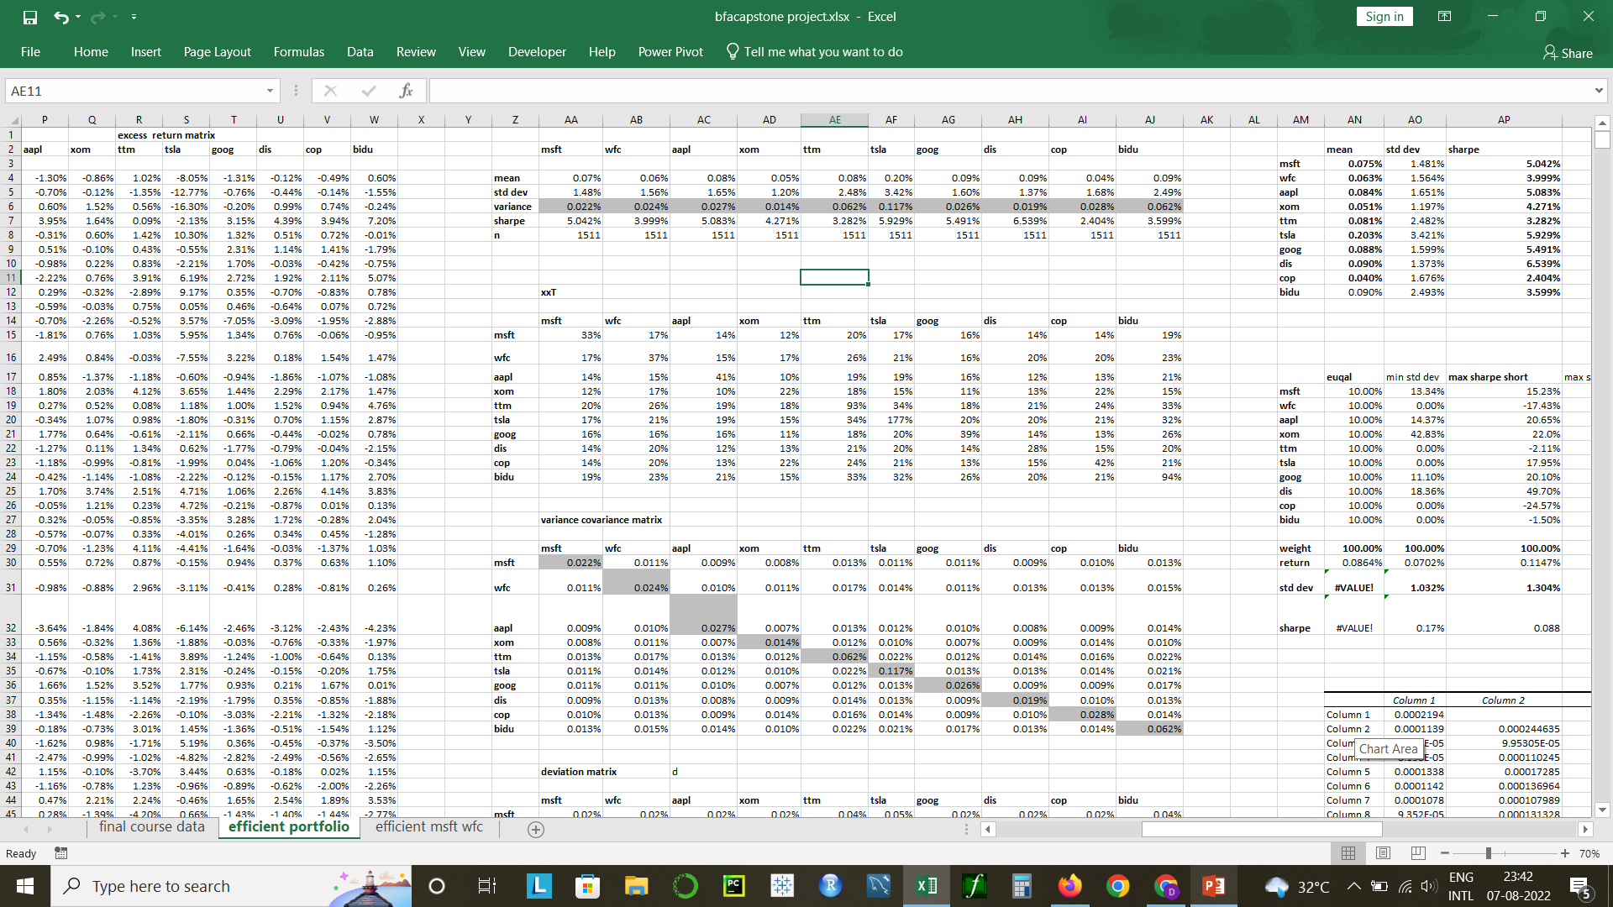
FINDINGS PRESENTATION
Average daily return
Summary statistics
Excees returns
Variance Covariance matrix
Portfolio summary statistics

Slide 5
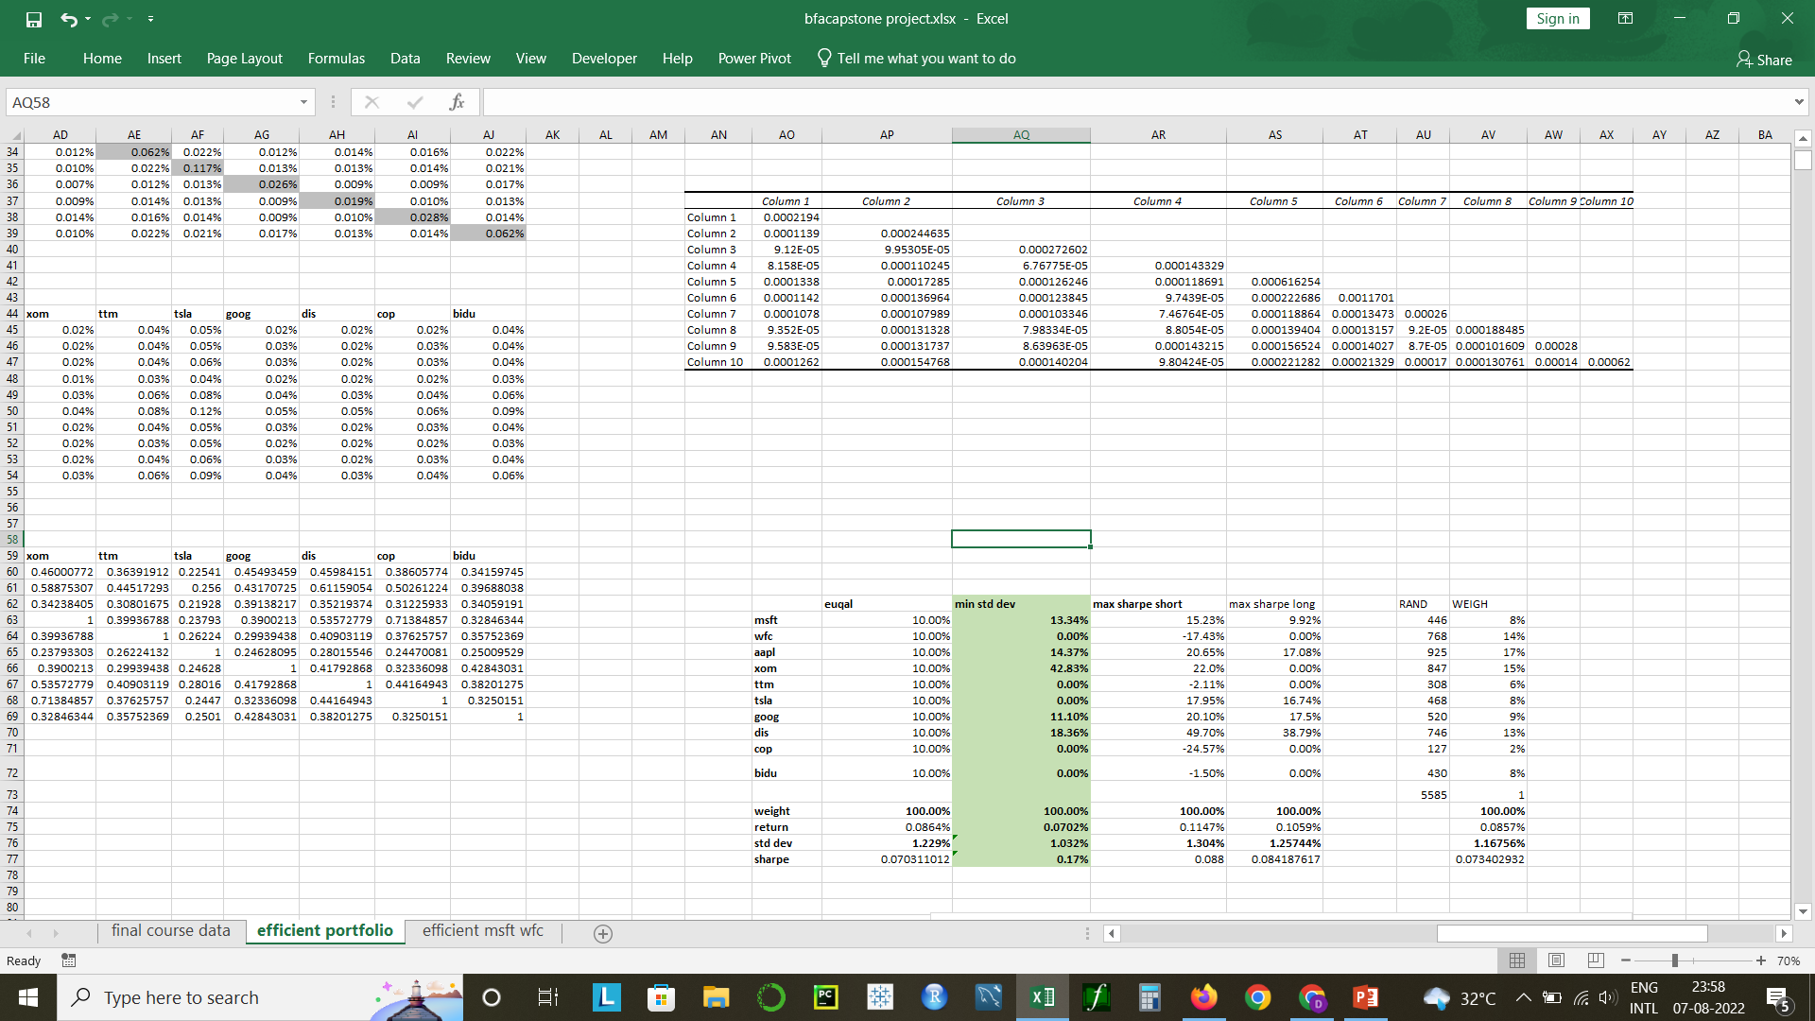
FINDINGS PRESENTATION
Optimal portfolio with excel solver

Slide 6
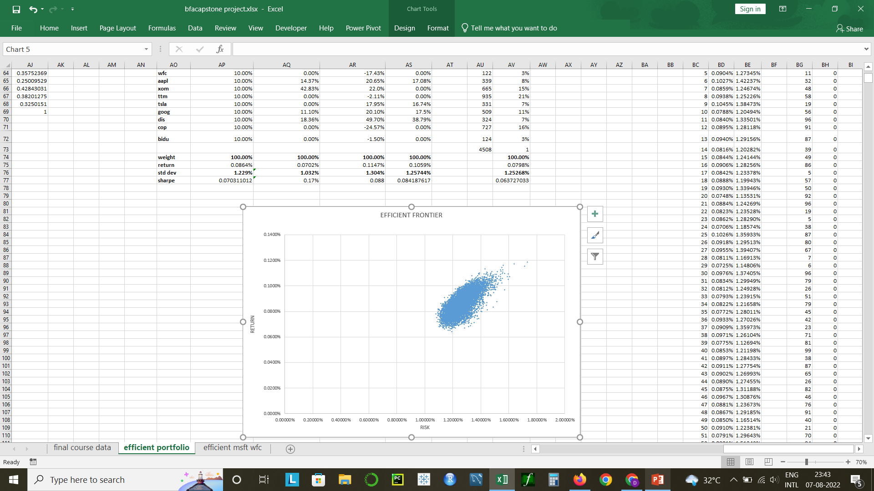
FINDINGS PRESENTATION
10000 simulation run for the efficient frontier graph

Slide 7
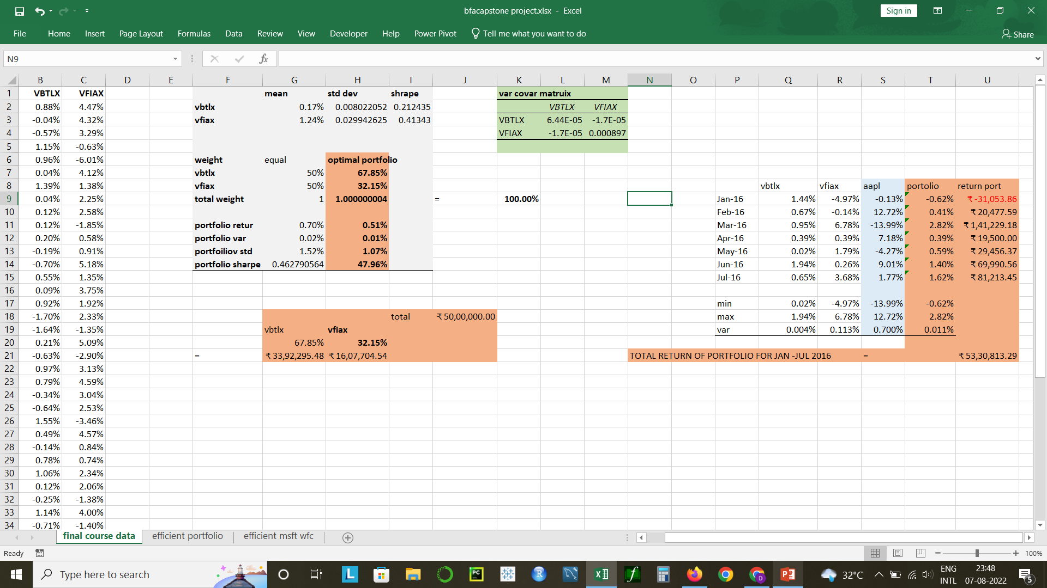
PORTFOLIO OPTIMIZATION OF VBTLX AND VFIAX
Portfolio optimization consisting of 2 funds with excel solver with the average daily return of the two securities for the period of jan 2012- dec 2015
Comparing the portfolio performance against the performance of apple stock for the period of jan 2016 – July 2016

Slide 8
CONCLUSION PORTFOLIO - VBTLX AND VFIAX for the period of jan-jul 2016
The sharpe ratio for the portfolio is significantly less than that of apple stock.
The risk is significantly high for apple stock.
The returns of apple stocks are also very high.
Portfolio diversification is required if an investor wants to to achieve highest returns for the lowest given risk

